Slide 1
Packet Forwarding Control Protocol
30 November 2021 Pradyum Kumar Singh

Slide 2
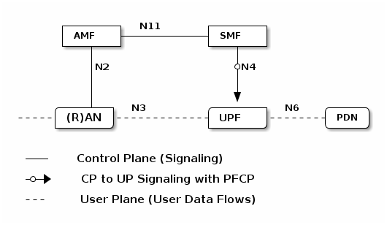
PFCP PROTOCOL
Packet Forwarding Control Protocol (PFCP) is a 3GPP protocol used on the N4 interface between the control plane and the user plane function.
Basic architecture of 5G core →

Slide 3
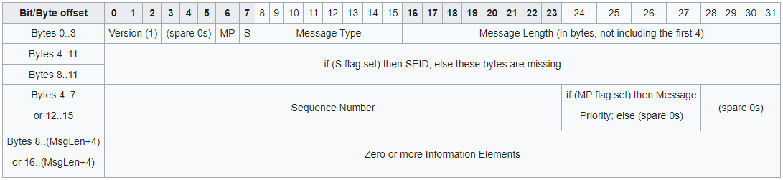
Message Format in PFCP
The Message Header length PFCP shall be of multiple of 4 Octets
S : If set then we will have 4 to 11 bytes for session Endpoint Identifier else we will have 4 to 7 bytes for Sequence number.
MP : If set then bit 4 to 7 of 15th byte will denote message priority.

Slide 4
PFCP Application In NSM
Cluster 1
Cluster 2
VL3 NSE ( Having remote IP of cluster 2)
PFCP Client
VL3 NSE ( Having remote IP of cluster 1)
PFCP Server
VL3 NSE
VL3 NSE
PFCP Client
PFCP Server
Vl3 Service (nsm0)
Note: Here the nsm service is annotated in client, so that the endpoint can reach the client when a connection request is received.

Slide 5
Thank you

